Slide 1
Introduction to Robotics
CSE 461
Class 11: Introduction to Control System Theory
Riad Ahmed
Lecturer
Brac University

Slide 2
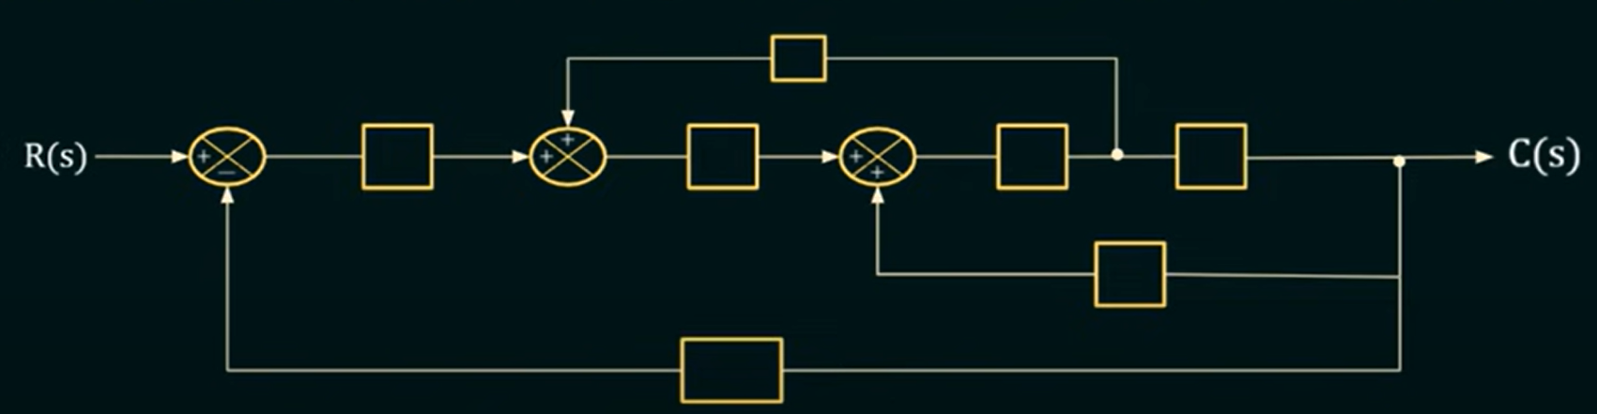

Slide 3
Block Diagram Solving

Slide 4
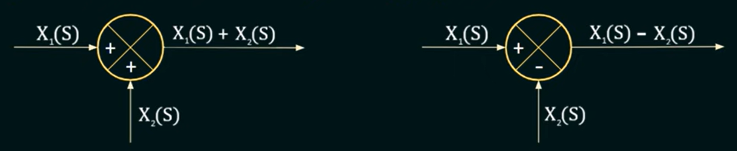
Summing Point

Slide 5
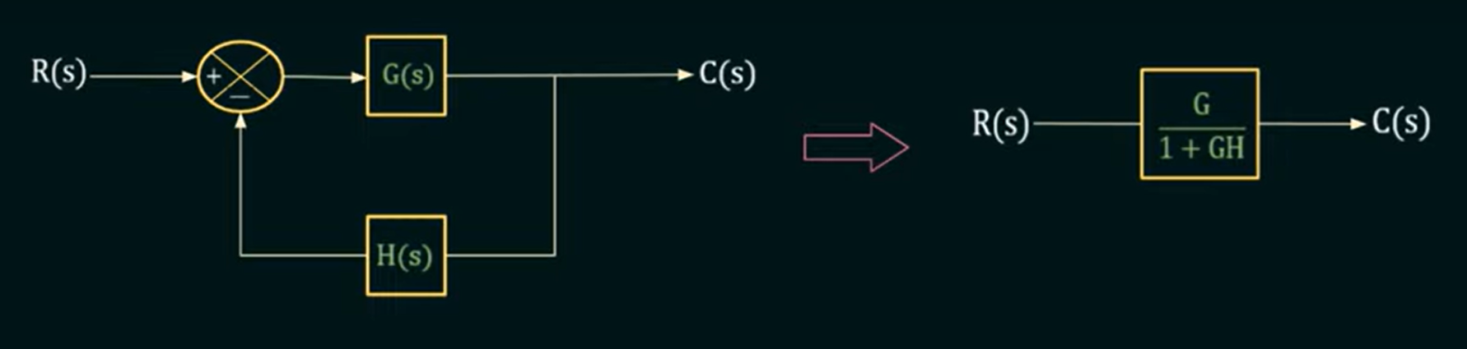
Rule : 1

Slide 6
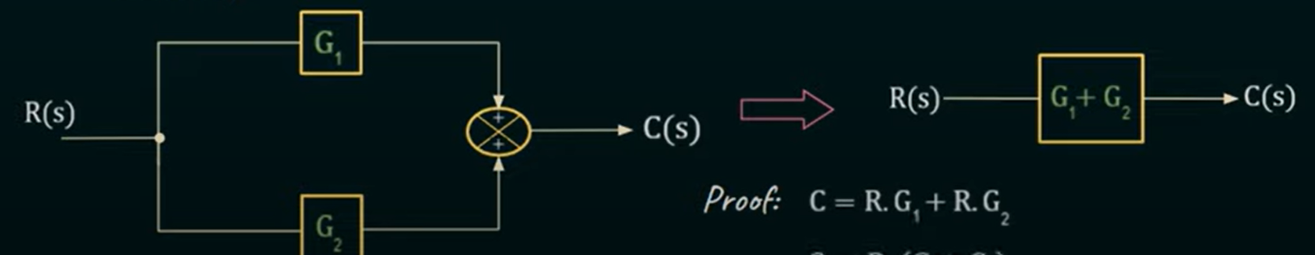
Rule : 2
Rule : 3

Slide 7
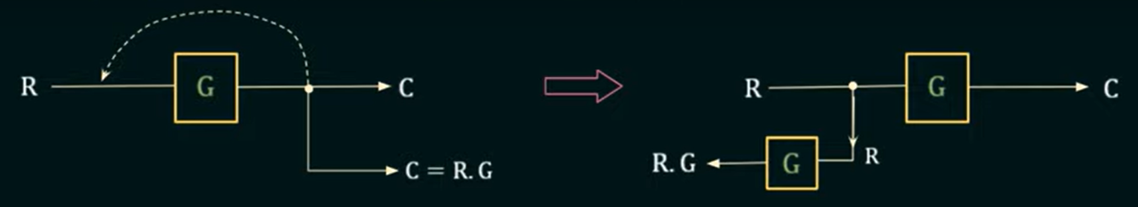
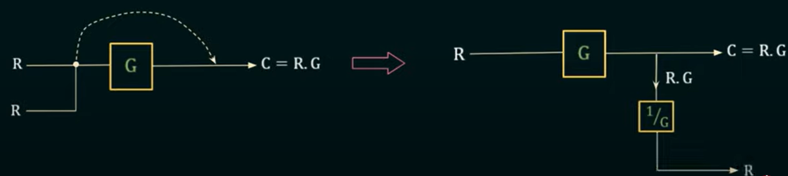
Rule : 4
Rule : 5

Slide 8
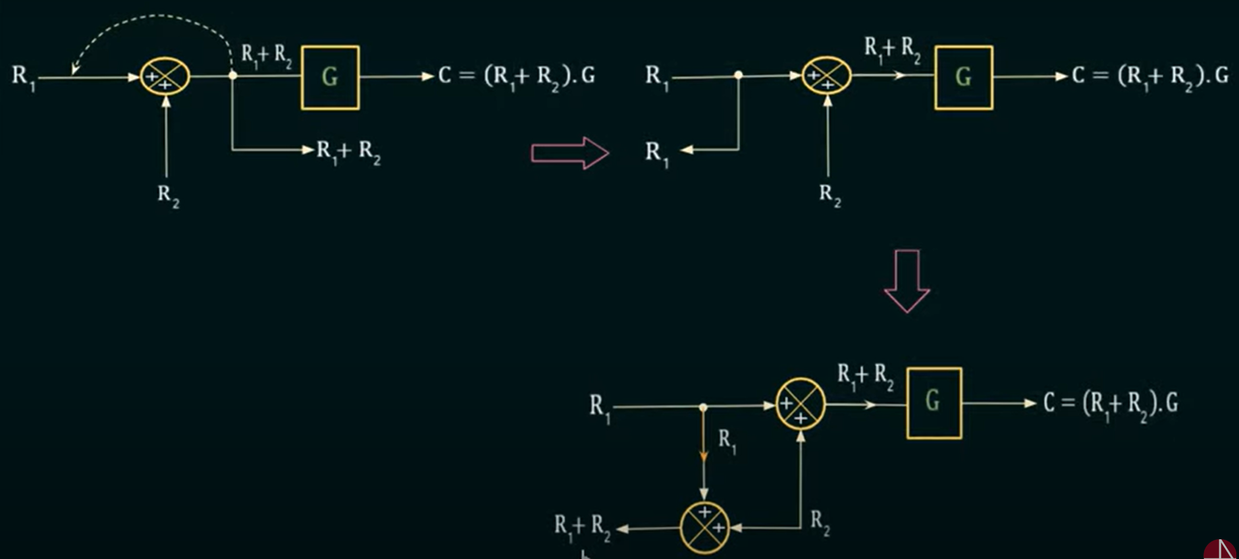
Rule : 6

Slide 9
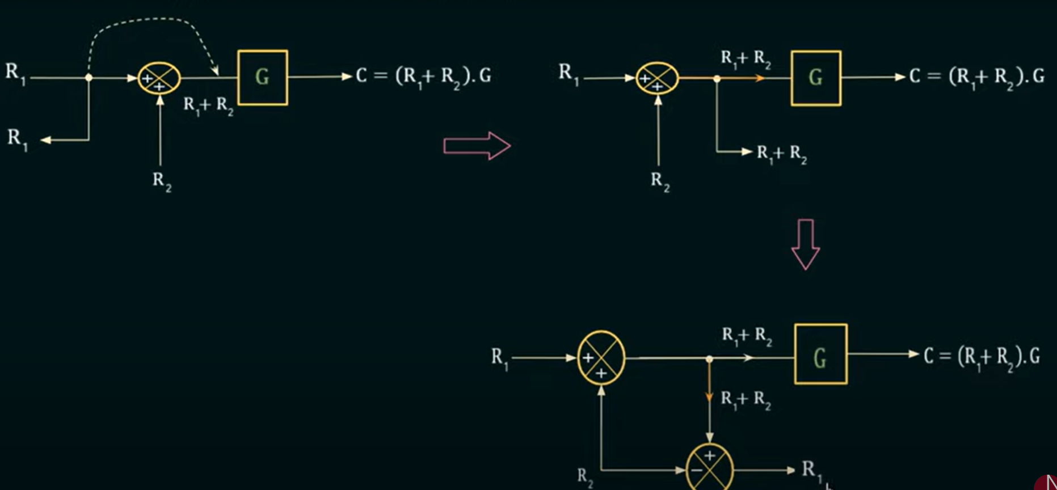
Rule : 7

Slide 10
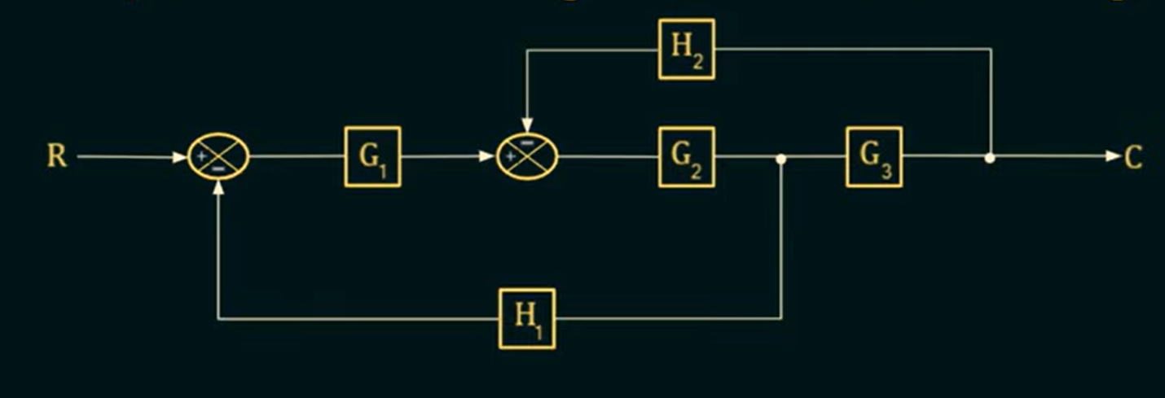
Problem 1:

Slide 11
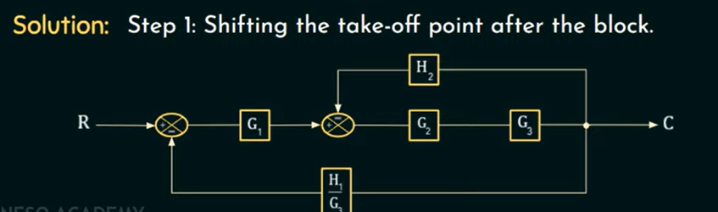

Slide 12
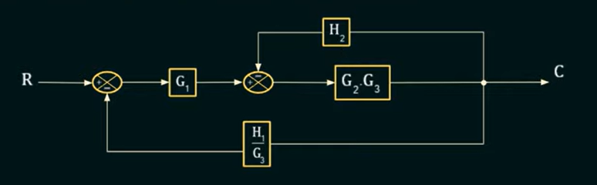

Slide 13
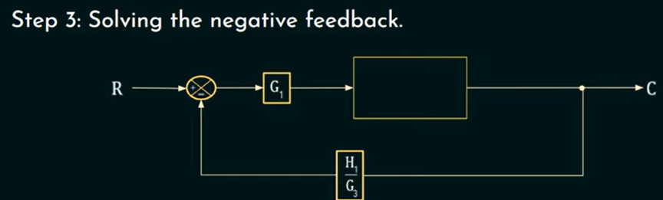

Slide 14
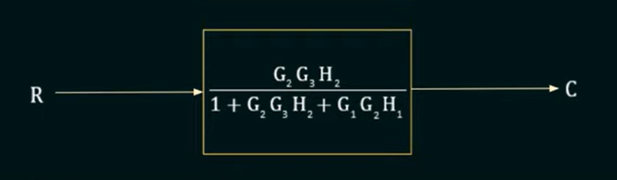
Result

Slide 15
Next Class
PID Control

Slide 16
Thank You

